Slide 1




Automatic Plant Watering System Using Arduino Uno
P H V PAVAN KUMAR – CB.EN.P2CEN20020
Guide :
Sajith Variyar V. V.
Computational Engineering & Networking
AMRITA SCHOOL OF ENGINEERING

Slide 2

INTRODUCTION
I used to get worried about my plants because they need water on regular basis. Because I used to forgot to irrigate them regularly and I gone through several options to solve this problem as plants need water according to the moisture level of soil. So I have made Automatic Plant Watering System Using Arduino UNO.
In this system, soil moisture sensor senses the moisture level of the soil. If soil will get dry then sensor senses low moisture level and automatically switches on the water pump to supply water to the plant. As plant get sufficient water and soil get wet then sensor senses enough moisture in soil. After which the water pump will automatically get stopped.
P H V PAVAN KUMAR – CB.EN.P2CEN20020 - CENTER OF COMPUTATIONAL ENGINEERING AND NETWORKING (CEN)

Slide 3


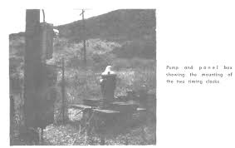


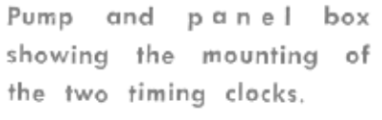


HISTORY
Necessity is the mother of invention
During that days irrigation to the plants is to done by hiring someone, Since there is no much automation is there.
As long as trees were small duration of irrigation was short it was not too bad.
There was water shortage when they use splitters at 1/3 gpm, which become critical when irrigation period was increase to 2 to 3hours
In late1960
Avocado Farm
G.L woflin
5-Feet
5-Feet
2-inches
2-inches
OFF
ON
P H V PAVAN KUMAR – CB.EN.P2CEN20020 - CENTER OF COMPUTATIONAL ENGINEERING AND NETWORKING (CEN)

Slide 4
Literature Review
1) HISTORY OF EARLIER AUTOMATION AND IRRIGATION
http://www.avocadosource.com/CAS_Yearbooks/CAS_52_1968/CAS_1968_PG_055-058.pdf
2) Automatic Plant Irrigation System using Arduino
https://ieeexplore.ieee.org/document/8326027
3) Automatic Plant Watering System using - Arduino UNO for University Park
https://www.researchgate.net/publication/334123772_Automatic_Plant_Watering_System_using_Arduino_UNO_for_University_Park
P H V PAVAN KUMAR – CB.EN.P2CEN20020 - CENTER OF COMPUTATIONAL ENGINEERING AND NETWORKING (CEN)

Slide 5
Literature Review
2) Automatic Plant Irrigation System using Arduino
This paper deals with an automatic plant irrigation system which automatically senses the moisture content of the soil and decide whether irrigation is needed or not and how much water is needed for soil.
This system uses AtMega328 microcontroller
Which is programmed to sense the moisture content if the soil over a period of time.
P H V PAVAN KUMAR – CB.EN.P2CEN20020 - CENTER OF COMPUTATIONAL ENGINEERING AND NETWORKING (CEN)

Slide 6
Literature Review
3) Automatic Plant Watering System using – Arduino UNO for University Park
To make the gardener works easily, the automatic plant watering system is created.
This system uses Arduino UNO board, which consists of ATmega328 microcontroller
This system automation is designed to be assistive for the University Park.
P H V PAVAN KUMAR – CB.EN.P2CEN20020 - CENTER OF COMPUTATIONAL ENGINEERING AND NETWORKING (CEN)

Slide 7
Problem Definition
Basically to automate the irrigation.
I am developing automate water monitoring system which will automate the irrigation system in the absence of human being also.
No need to monitor the plant or the cultivation area.
No wastage of water.
By supplying sufficient amount of water to plant one can grow the plants and cultivate in a better way.
One can reduce human efforts.
So, basically like a one time investment.
P H V PAVAN KUMAR – CB.EN.P2CEN20020 - CENTER OF COMPUTATIONAL ENGINEERING AND NETWORKING (CEN)

Slide 8

Objectives
So Basically to automate the plant watering system which monitors the plant at regular basics and supplies the water when the soil moisture sensor senses low moisture level of water in the soil with out the presence of human being so one can do there work in an effective way and no need to worry about watering there plants frequently.
P H V PAVAN KUMAR – CB.EN.P2CEN20020 - CENTER OF COMPUTATIONAL ENGINEERING AND NETWORKING (CEN)

Slide 9
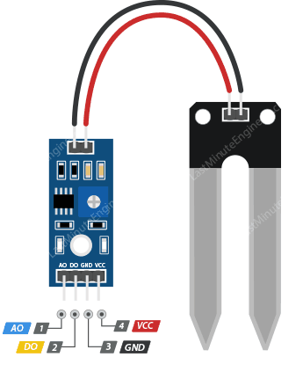
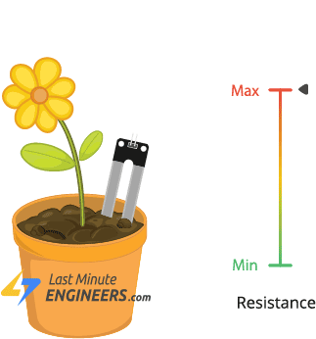
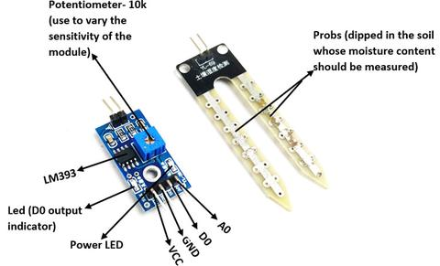
Methodology
pin gives us an analog signal between the supply value to 0V and will be connected to one of the analog inputs on your Arduino.
pin supplies power for the sensor. It is recommended to power the sensor with between 3.3V – 5V. Please note that the analog output will vary depending on what voltage is provided for the sensor.
pin gives Digital output of internal comparator circuit. You can connect it to any digital pin on an Arduino or directly to a 5V relay or similar device.
ground connection
The soil moisture sensor consists of two leads that are used to measure volume of water content in soil. These leads allow the current to pass through the soil and in return calculates the resistance value to measure the moisture level. If there is more water in soil then soil will conduct more electricity, means less resistance value along with high level of moisture. In the same manner if there is less water in soil then soil will conduct less electricity, means high resistance value along with low level of moisture.
P H V PAVAN KUMAR – CB.EN.P2CEN20020 - CENTER OF COMPUTATIONAL ENGINEERING AND NETWORKING (CEN)

Slide 10
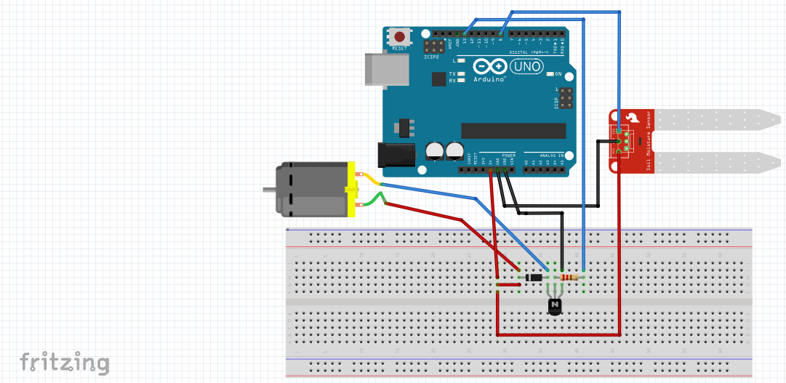

Circuit Connection
P H V PAVAN KUMAR – CB.EN.P2CEN20020 - CENTER OF COMPUTATIONAL ENGINEERING AND NETWORKING (CEN)

Slide 11
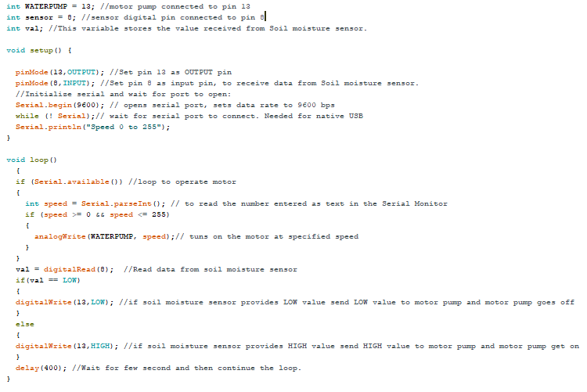
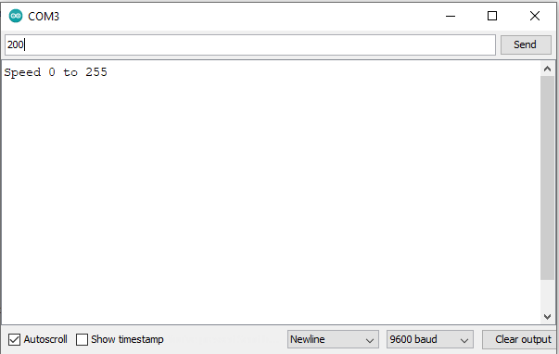
Code
P H V PAVAN KUMAR – CB.EN.P2CEN20020 - CENTER OF COMPUTATIONAL ENGINEERING AND NETWORKING (CEN)

Slide 12
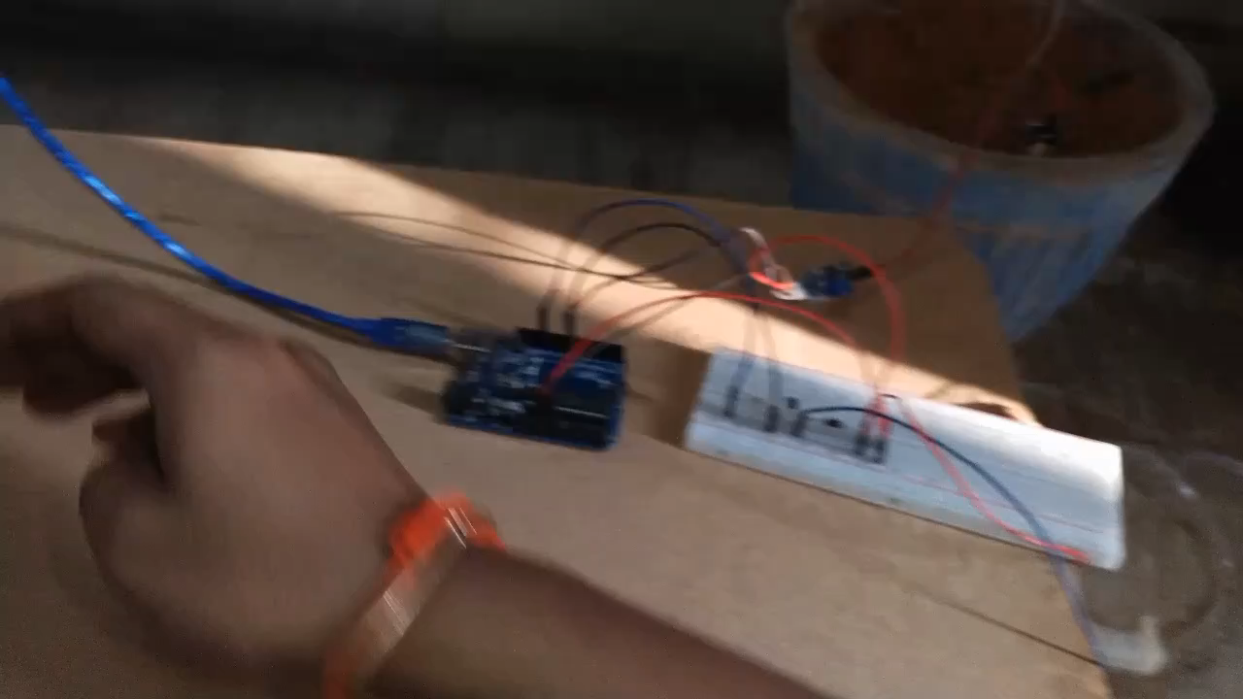
Results
P H V PAVAN KUMAR – CB.EN.P2CEN20020 - CENTER OF COMPUTATIONAL ENGINEERING AND NETWORKING (CEN)

Slide 13
Papers published/submitted (based on the project work
1) Automatic Plant Irrigation System using Arduino
https://ieeexplore.ieee.org/document/8326027
2) Automatic Plant Watering System using - Arduino UNO for University Park
https://www.researchgate.net/publication/334123772_Automatic_Plant_Watering_System_using_Arduino_UNO_for_University_Park
P H V PAVAN KUMAR – CB.EN.P2CEN20020 - CENTER OF COMPUTATIONAL ENGINEERING AND NETWORKING (CEN)

Slide 14
Future work
The scope of soil moisture sensor is increasing day by day, the use of soil moisture sensors in residential areas is aiding the soil moisture sensor market.
Soil moisture market is now backed by sports segment, which has resulted in increased demand of soil moisture sensors to maintain the grounds. For instance soil moisture sensors are used to maintain golf turfs the rise in such practice will be addition to the market of soil moisture sensors.
Weather Forecasters make use of soil moisture sensors which is another driving factor for the soil moisture sensor market. As soil moisture sensors are helpful in providing reading that is helpful in weather forecasting.
P H V PAVAN KUMAR – CB.EN.P2CEN20020 - CENTER OF COMPUTATIONAL ENGINEERING AND NETWORKING (CEN)

Slide 15
References
http://www.avocadosource.com/CAS_Yearbooks/CAS_52_1968/CAS_1968_PG_055-058.pdf
https://ieeexplore.ieee.org/document/8326027
https://www.researchgate.net/publication/334123772_Automatic_Plant_Watering_System_using_Arduino_UNO_for_University_Park
P H V PAVAN KUMAR – CB.EN.P2CEN20020 - CENTER OF COMPUTATIONAL ENGINEERING AND NETWORKING (CEN)

Slide 16

Thank you…Sir
P H V PAVAN KUMAR – CB.EN.P2CEN20020 - CENTER OF COMPUTATIONAL ENGINEERING AND NETWORKING (CEN)

